Slide 1
Opening of Turkish Restaurant in Bucharest

Slide 2

Business Problem
Bucharest is the capital and greatest city of Romania, just as its social, modern, and budgetary focus having 1.883.425 population.
Opening new Turkish café in Bucharest might be productive for eatery proprietor. Our concern is Where to open Turkish eatery in Bucharest?

Slide 3
Data Sources
I get the neighborhood information of Bucharest from Wikipedia
I get the neighborhood information of Bucharest from Wikipedia
I use python geocoder library to get topographical directions of neighborhoods
I use Foursquare API venues explore method to get the settings of given neighborhoods of Bucharest.
I use Foursquare API settings strategy to get positions and likes of eateries by given scene id.

Slide 4
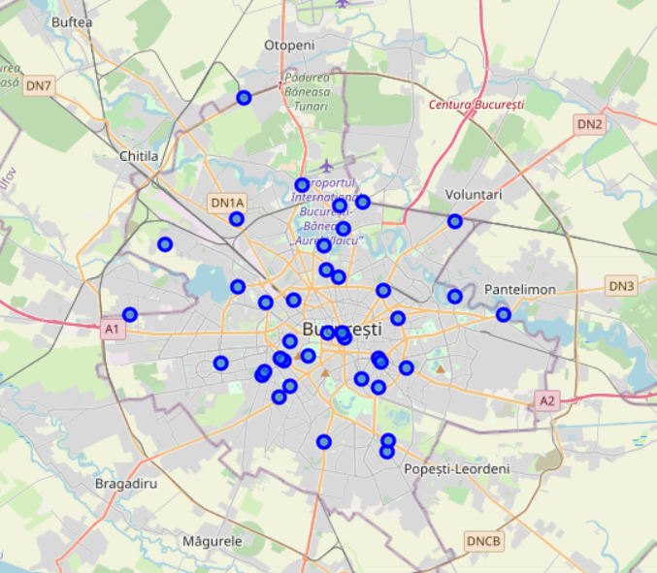
Methodology
I took neighborhood from wikipedia and put blue dots on Bucharest map to see centers of neighborhoods. There are 40 neighborhoods in Bucharest

Slide 5
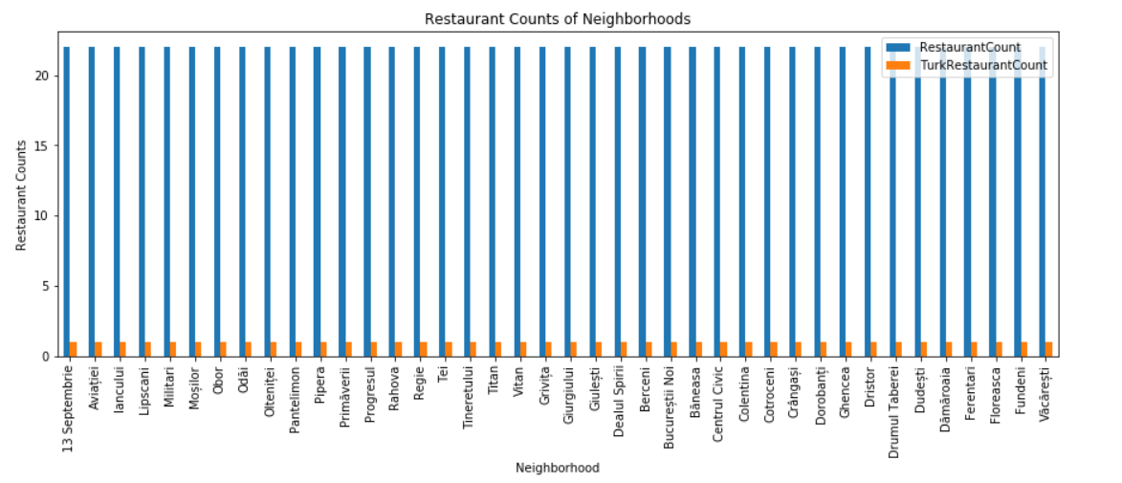
Methodology
By using Foursquare API I got venues 1 km around center of each neighborhood with limit 100 venue. I merged data with Neighborhood data.
I filtered All restaurants and Turkish restaurant. We can see from histogram of restaurants

Slide 6
Methodology
I superimposed Turkish restaurants with red markers on map and blue markers as Turkish restaurants with rating less than 7 restaurants. That means these restaurants are not liked too much.
I superimposed neighborhoods without any Turkish restaurant with cyan markers in another heat map.

Slide 7
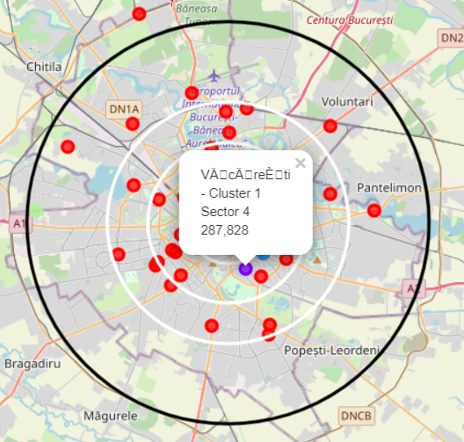
Methodology - Clustering
Agglomerative Clustering gives 6 clusters:
Cluster 0 ( Red ) : Italian Restaurant , Pizza, Café
Cluster 1 ( Purple) : Restaurant , Bar
Cluster 2 (Blue) : Park , Plaza, Clothing stores , Museum, Gym
Cluster 3 (Cyan) : Coffee Shop, Hotel, Pub
Cluster 4 (Green) : Café, Supermarket
Cluster 5 (Orange) : Café

Slide 8
Results
Turkish restaurant counts in Bucharest is 4.55%
Total number of restaurants: 22
Total number of Turkish restaurants: 1

Slide 9
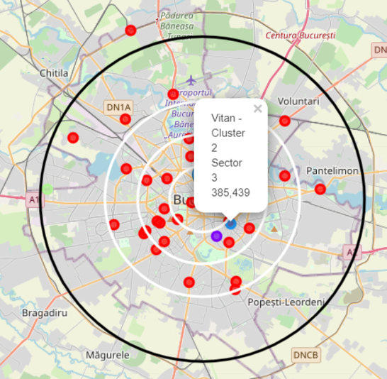
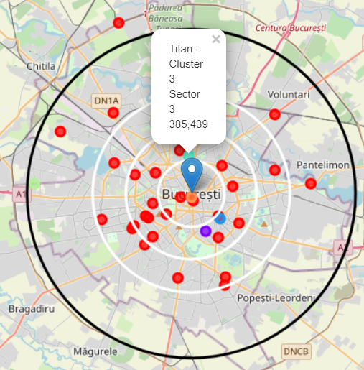
Conclusion
I have picked 3 areas for opening Turk eatery. The following are areas of neighborhoods. I trust this work will help someone who needs to open another Turkish eatery in Bucharest

Slide 10
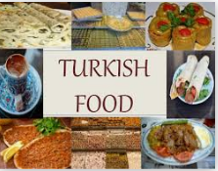
Thank You…

